Slide 1

Enhanced Genome-Based Taxonomy for Precise Identification of Fungal and Oomycete Pathogens Using LINs
Kassaye Belay
APS Plant Health 2025

Slide 2
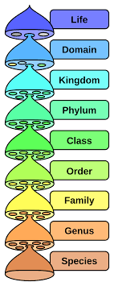
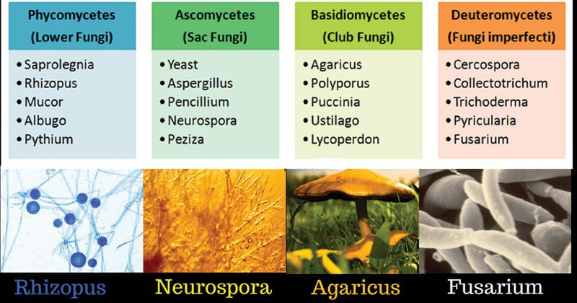
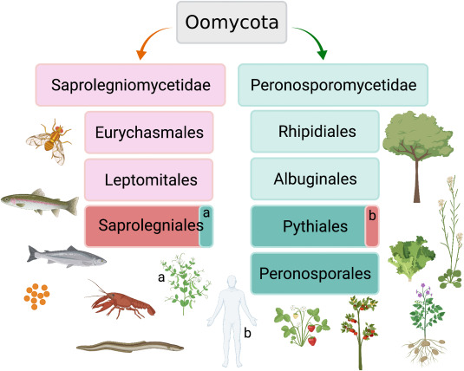
Classification of Fungi & Oomycetes
1. Morphology
Hyphal form: septate vs. coenocytic
Yeast vs. filamentous growth
Sporangium/conidiophore structure
2. Molecular Phylogeny
Marker genes: rDNA (ITS, SSU, LSU), RPB1/2, TEF1α
Multi-locus & whole-genome
3. Genomic & Metagenomic Signatures
Average nucleotide identity (ANI) value
k-mer based (containment) for community profiling
Life Identification Numbers (LINs) for rapid genome assignment
https://microbenotes.com/classification-of-fungi/
https://en.wikipedia.org/wiki/Kingdom_(biology)
https://www.sciencedirect.com/topics/agricultural-and-biological-sciences/oomycetes

Slide 3
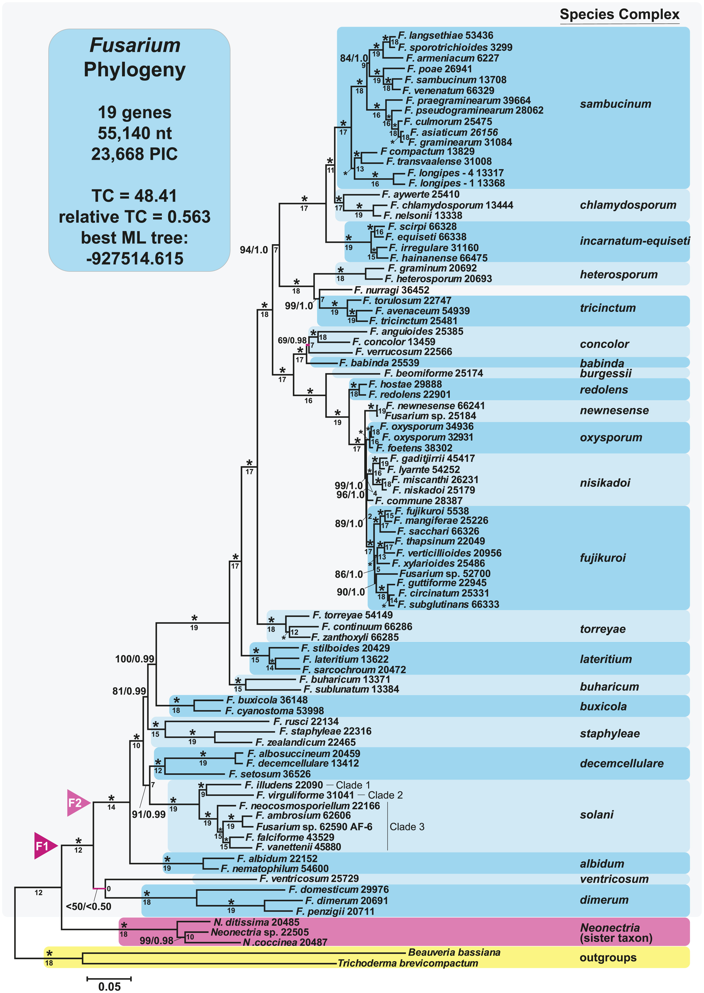
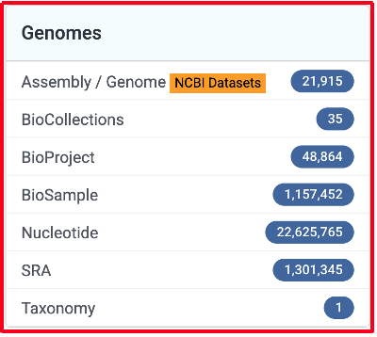
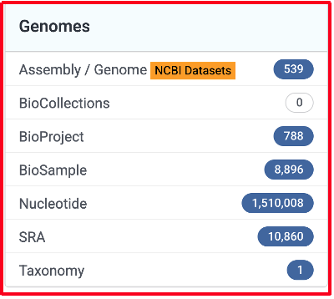
Genome Based Taxonomic Methods
Fungi
Single-/few-locus phylogenies
Uses classic barcodes (ITS, LSU, etc.)
Fast, simple, good for species ID
Limited resolution for deeper splits
Multi-locus sequence analysis (MLSA)
Combines several housekeeping genes
More robust than single locus
Requires careful gene selection
Phylogenomics / genome-scale
Uses hundreds to thousands of genes (e.g., BUSCO, whole genomes)
Highest resolution, captures complex histories
Computationally demanding, needs high-quality genomes
Oomycota
Geiser et al., 2021

Slide 4
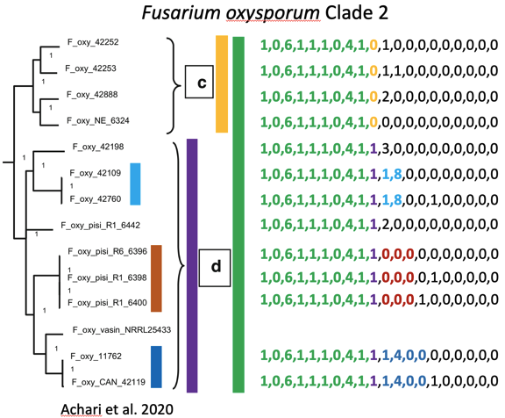

LINs for Fungi and Oomycetes
Input: assembled genomes
Numbers are used as class labels
LIN assignment is based on the k-nearest neighbor
ANI can be computed directly or inferred from Jaccard distance
Genome Similarity Methods
Sourmash
K-mer based
Constructs deterministic hash for genomes (signatures/sketches)
Scalable or fixed hash size
Jaccard, predicted ANI, containment similarity results
Notes:
This figure demonstrates the use of Life Identification Numbers (LINs) for fungal classification. Shown is a core genome phylogeny of Fusarium oxysporum Clade 2, constructed from 6,800 genes. The LINs (right) provide detailed resolution of classification and branching within the clade, illustrating how genomic data can distinguish lineages at fine scales.

Slide 5
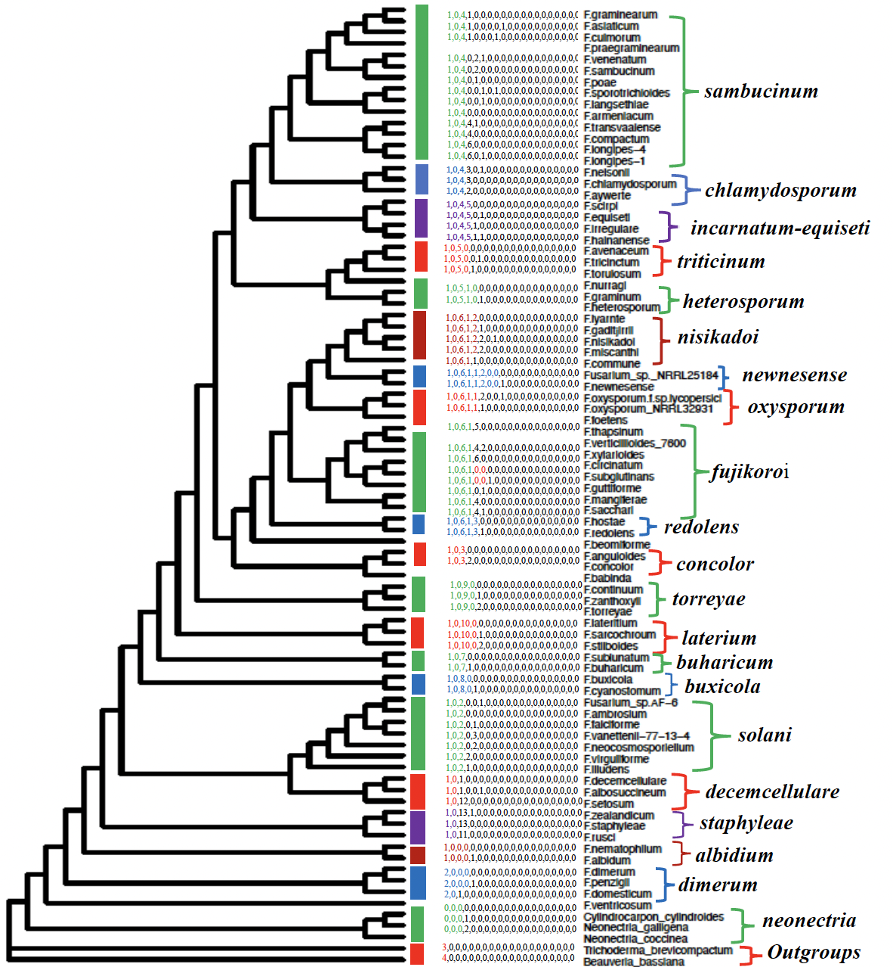
LINs for Fungi and Oomycetes
Figure 1
Figure 2
Notes:
Figure 1 shows the Geiser et al., 2021 reference tree,
Figure 2 shows the core genome tree after assigning LINs using LINflow for the Geiser genomes dataset. Most species complexes share the LIN prefix 1A, except for the F. dimerum complex, which has the prefix 2A. The outgroup genera have distinct LIN prefixes 0A (Neonectria), 3A (Trichoderma), or 4A (Beavernia bassiana).
The use of LINs allows for delimiting the genus Fusarium and its species complexes.
The LIN pipeline and LINbase can be used to accurately assign LINs to Fusarium species and determine their evolutionary relationships.
LINs separate all species complexes from each other, indicating that they are a reliable and robust method for delimiting Fusarium species and species complexes, but LINflow is very slow when assigning LINs to fungal genomes because of the much larger genome size.

Slide 6
Summary and Future work
LIN assignments are effective for classifying most fungal and oomycete genera.
LINs show strong potential for delimiting fungal and oomycete taxa.
LINs were assigned using ANI estimates from Sourmash.
Next Steps:
Developing a genomeRxiv resource for fungal and oomycete taxa.
Add all fungal and Oomycete genomes to genomeRxiv.
Construct core genome trees to benchmark LIN assignments for fungal and oomycete genera.
Compare LIN-based assignments with core genome trees, species complexes, species, and formae speciales.

